Slide 1
Exploration of mars via unmanned spacecraft
David Wallie
Notes:
In many ways, the study of Mars provides Earth-bound scientists with a control set as they look at the processes of climate change, geophysics, and the potential for life beyond our own planet
Unraveling the story of water on Mars is important to unlocking its climate history, which will help us understand the evolution of all the planets. Water is an essential ingredient for life as we know it. Evidence of long-term past or present water on Mars holds clues about whether Mars could ever have been a habitat for life.

Slide 2
Background
Past
Present
Future
Mariner 3 & 4
Mariner 6 & 7
Mariner 8 & 9
Viking 1 & 2
Mars Observer
Mars Global Surveyor
Phoenix
Mars Polar Lander/Deep Space 2
Mars
Mars Odyssey
Spirit and Opportunity
Mars Express
Mars Reconnaissance Orbiter
Mars Science Laboratory
MAVEN
ExoMars/Trace Gas Orbiter
Mars 2018 Mission
2020 Mission Plans
NASA In 2016 ExoMars Orbiter
NASA In 2018 ExoMars Rover
Insight

Slide 3
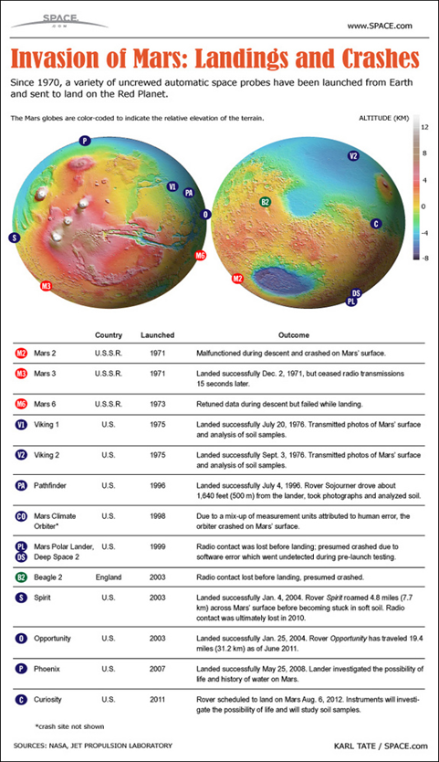
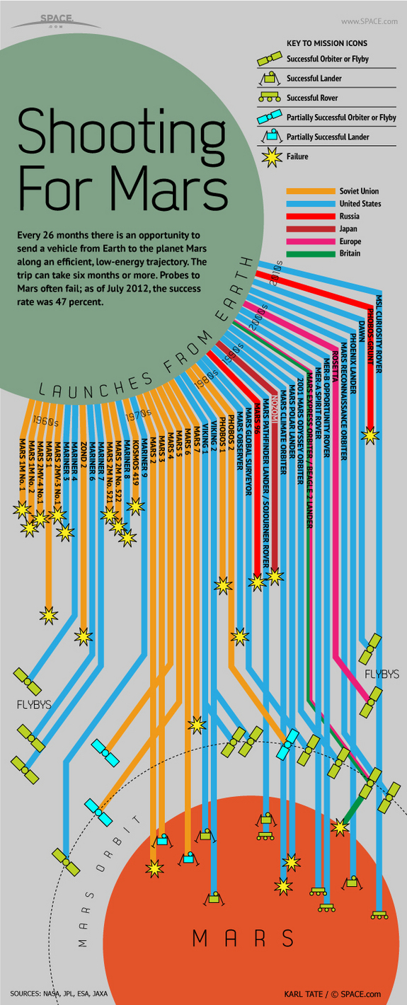
Mission Types
Orbiters
Landers
Rovers
Airplanes
Balloons
Subsurface Explorers
Sample Returns
Notes:
CURRENT
Flybys: When we were just starting out in solar system exploration, the very first missions simply flew by Mars, taking as many pictures as possible on their way past
Flyby missions include: Mariner 3-4 | Mariner 6-7Orbiters: Mariner 8-9 | Viking 1-2 | Mars Observer | Mars Global Surveyor | Mars Climate Orbiter | 2001 Mars Odyssey | Mars Express | Mars Reconnaissance Orbiter | Mars Atmosphere and Volatile Evolution | NASA In 2016 ExoMars Orbiter
Landers & Rovers:
Then, with even more capabilities over the years, we began to land on the surface. Today, we're not only landing in one place, but have shown that we can be mobile on the surface of Mars Landed missions include: Viking 1-2 | Pathfinder | Polar Lander/Deep Space 2 | Mars Exploration Rovers | Phoenix | Mars Science Laboratory | NASA In 2018 Exomars Rover | 2020 Mission Plans
Future
Subsurface Explorers: Going below the ground will tell us more about the geology of the planet, the presence of water, and maybe even clues about whether Mars was ever a habitat for life
Sample Returns: Bringing samples of Martian rocks, soils, and atmosphere back to Earth would give us the opportunity to study the red planet close-up, in laboratories here on Earth
Mars 2020 rover, seeking signs of past life, also will demonstrate new technologies that could help astronauts survive on Mars.
NASA is developing the capabilities needed to send humans to an asteroid by 2025 and Mars in the 2030s - goals outlined in the bipartisan NASA Authorization Act of 2010 and in the U.S. National Space Policy, also issued in 2010. Mars is a rich destination for scientific discovery and robotic and human exploration as we expand our presence into the solar system. Its formation and evolution are comparable to Earth, helping us learn more about our own planet's history and future.
Over one hundred years ago, in 1903, human flight on Earth began with the Wright Brothers' epic flight at Kitty Hawk. Today, scientists and engineers hope to fly a Mars airplane sometime in the next decade. Current research is underway to design an airplane that could navigate on its own without human pilots. These airplanes would be able to gather better images of the surface and cover more territory than current orbiter or rover technologies allow.
Because the Martian atmosphere is so thin, taking off from the ground would require very big wings or a very fast take-off. One solution to this problem is to have the airplane drop off an entry vehicle as it is coming into the Martian sky. As the plane drops off, the wings would unfold and it would start flying, powered either by batteries or by gliding through the air. A likely place to fly airplanes would be in valleys or other interesting places where there is a lot to see over great distances.
Although this flight would be relatively short (less than an hour), and shorter than a balloon flight, an airplane is more controllable and can be directed to closely approach areas of scientific interest. To receive even more data from an airplane, engineers are also engaged in further research that will give them insight into how to make a Mars airplane stay aloft for longer periods of time.

Slide 4
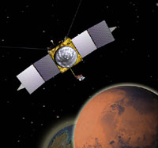
MAVEN
Launch: Nov. 18, 2013, 10:28 a.m. PST (1:28 p.m. EST) Launch Window: Nov. 18-Dec. 7, 2013
MAVEN (Mars Atmospheric and Volatile EvolutioN) is the second mission selected for NASA's Mars Scout program, an initiative for measurements of the Martian atmosphere to help understand dramatic climate change on the red planet over its history
MAVEN will provide information on how and how fast atmospheric gases are being lost to space today, and infer from those detailed studies what happened in the past. Studying how the Martian atmosphere was lost to space can reveal clues about the impact that change had on the martian climate, geologic, and geochemical conditions over time, all of which are important in understanding whether Mars had an environment able to support life
Mars Orbit Insertion: Sept. 21, 2014, 7:24 p.m. PDT (10:24 p.m. EDT)

Slide 5
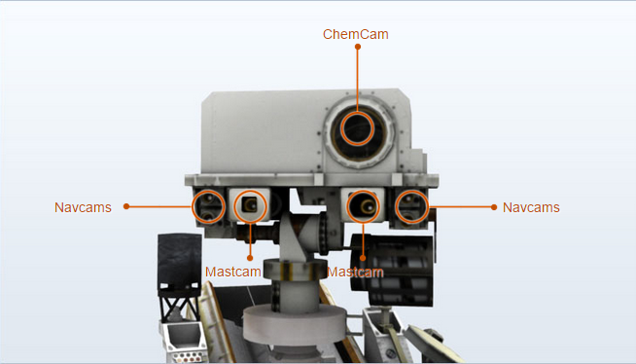
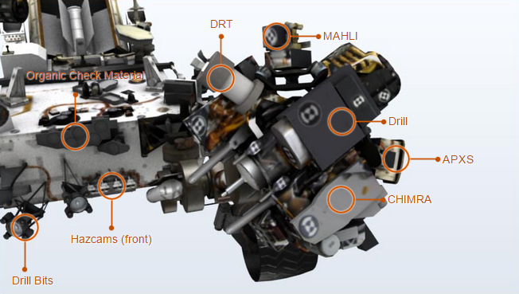
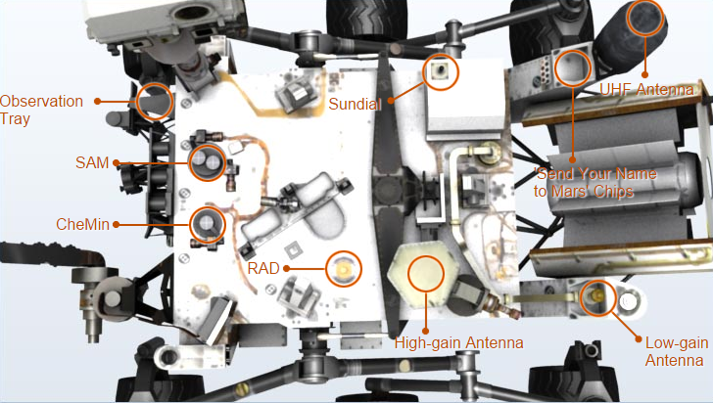
Curiosity
Curiosity was designed to assess whether Mars ever had an environment able to support small life forms called microbes. In other words, its mission is to determine the planet's "habitability." The rover carries the biggest, most advanced suite of instruments for scientific studies ever sent to the Martian surface The rover will be able to roll over obstacles up to 75 centimeters (29 inches) high and travel up to 90 meters (295 feet) per hour. On average, the rover is expected to travel about 30 meters (98 feet) per hour, based on power levels, slippage, steepness of the terrain, visibility, and other variables.
Mission name: Mars Science Laboratory
Rover name: Curiosity rover
Size: About the size of a small SUV -- 10 feet long
(not including the arm), 9 feet wide and 7 feet tall
(about 3 meters long (not including the arm), 2.7 meters wide,
and 2.2 meters tall), or about the height of a basketball player.
Arm Reach: About 7 feet (2.2 meters)
Weight: 900 kilograms (2,000 pounds)
Features: Geology lab, rocker-bogie suspension,
rock-vaporizing laser and lots of cameras

Slide 6
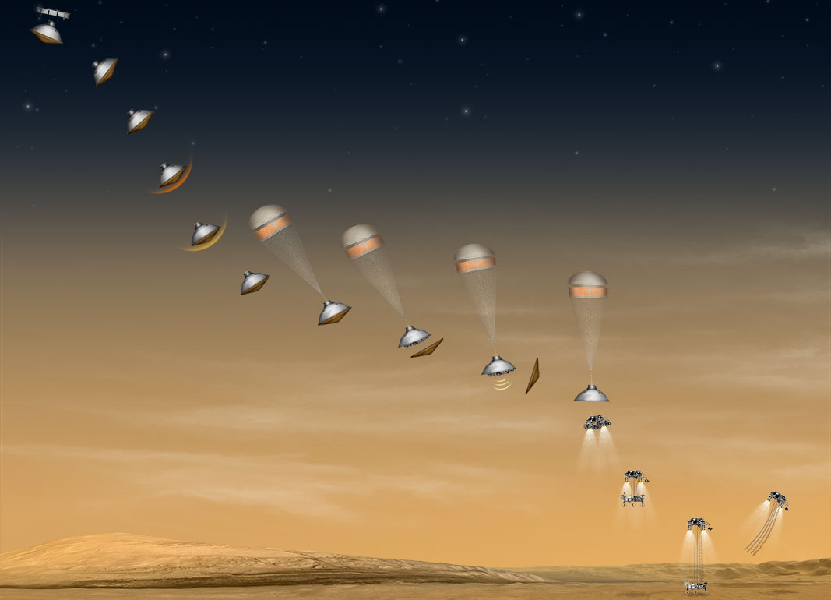
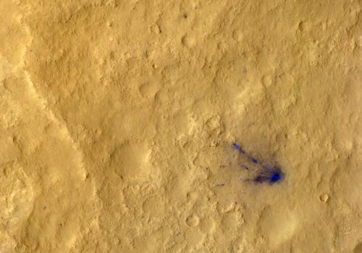
Curiosity
In a maneuver that had never been tried before on another planet, a rocket-powered sky crane lowered Curiosity to the Martian surface on cables, then flew off and crash-landed intentionally a safe distance away. NASA officials say this technique should help land other big payloads in the future, helping pave the way for human outposts on the Red Planet. Curiosity also landed with unprecedented precision, thanks to a new guided entry system that will aid future missions as well. The rover touched down within a target ellipse that measured just 12 miles long by 4 miles wide (20 by 7 kilometers) — a huge improvement from the 2004 landing of NASA's twin Spirit and Opportunity rovers, whose ellipses spanned 93 miles by 12 miles (150 by 20 km).
Notes:
Racing toward Mars, 10 minutes before reaching the atmosphere, the cruise stage ejects and then burns up in the atmosphere. Mission complete, cruise stage. Thanks for bringing the Curiosity rover 354 million miles (570 million kilometers) through the cold void of space. On the heat shield, an instrument named MEDLI turns on. It's ready to measure how hot the spacecraft gets from the extreme friction of a rapid descent through the Martian atmosphere. Predictions are two times hotter than the space shuttle upon Earth entry! It will also measure how the spacecraft's orientation changes in interacting with the dynamic atmosphere. Engineers are excited about this data, the first collected in the atmosphere since the 1970s Viking landers. It will help improve the design of future missions to Mars, making them safer, more reliable, and lighter weight!
A brand-new method for guided entry and precision landing. Going a ripping 5.8 kilometers per second, the spacecraft ejects two solid tungsten weights - each about 165 pounds (75 kilograms) and the size of a laptop-- shifting the spacecraft's center of mass. With small thrusters at the ready, the aeroshell containing the Mars rover Curiosity can now generate lift and use it. That helps improve landing accuracy from hundreds of miles to about 12 miles (20 kilometers). For comparison, the Mars Phoenix Lander had a landing ellipse the size of Gale Crater, but the Mars rover Curiosity will land within a small area inside of Gale. Talk about self control! It's a big deal. It means we can go places we've never gone before, able to land safely in thousands of sites rather than a handful. It means that, no matter where it lands, the rover can be in driving range of the rocks and minerals that may hold clues to the possibility of life on Mars.
Get ready, get set, go! From the official starting line of entry, descent, and landing (EDL), it's all about self-steering! Entering the atmosphere almost 80 miles (125 kilometers) above the martian surface, wind shear in the upper atmosphere swipes violently at the spacecraft. Taming this wild ride, small thrusters on the backshell adjust the angle and direction of the spacecraft's lift to head toward the landing site. Carving a path through the martian atmosphere in a series of "S-shaped" curves, the aeroshell begins to slow down dramatically from 13,200 mph to 1,000 mph (5.9 kilometers per second to 0.45 kilometers per second)
Eighty seconds after entering the atmosphere, it's hotter than hot! Due to the spacecraft's huge size*, the heat shield reaches the hottest temperature ever for any Mars entry vehicle, about 3,800 degrees Fahrenheit (2,100 degrees Celsius). Engineers had to coat the entire outside with a honeycomb of special materials to avoid any "melt downs"! As hot as it gets on the outside, though, the Curiosity rover stays at a cozy temperature of 32 to 77 degrees Fahrenheit (0-25 degrees Celsius) inside the aeroshell. About 14.8 feet (4.5 meters) in diameter and some 6,950 pounds (3,152 kilograms)!
Hold on tight as friction in the atmosphere slams on the "brakes"! The heat shield takes the brunt of it, slowing the spacecraft from 13,200 to 1,000 miles per hour (5.9 to 0.45 kilometers per second). That's reducing about 90 percent of the kinetic energy the spacecraft had when it first hit the atmosphere.
The capsule's shape and mass offset keeps the air pressure lower on one side of the capsule, producing lift. That's a little like the way airplane wings work. They change angles and tilt to create lower air pressure on top and greater on the bottom, creating the lift that allows them to fly. Yet, unlike birds or your average plane, the spacecraft is travelling at hypersonic speeds-that's more than Mach 5! At that speed, molecules of air break apart, creating hot plasma around the spacecraft. Shock waves cause air density and pressure to waver dramatically, so being quick to respond by design is vital.
Whoosh! Out pops the parachute, about 255 seconds after entry and 7 miles (11 kilometers) above the martian surface. Think of looking out your window on your next long-distance plane ride-it roughly opens at the same height of a commercial passenger plane. But, now imagine rushing down from that height at 900 miles per hour (405 meters per second). That's Mach 2, the top speed of an F18 fighter jet! Luckily, the parachute slows the spacecraft down a lot more, about 9% of its original energy on atmospheric entry. Using the same shape and materials as past Mars landers and rovers, Curiosity's parachute is over two times larger by area than those used for the Mars Phoenix lander and the Mars Exploration Rovers Spirit and Opportunity.
When the spacecraft is about 5 miles (8 kilometers) above the surface of Mars, zipping down now at a mere Mach .7 (about 310 miles per hour or 140 meters per second), the heat shield pops off and drops away. Bye bye, heat shield. Job "well done" and a "toast" to you! You took a lot of heat in getting the job done! With the heat shield whisked away, it's a little like taking off a lens cap. The Mars Descent Imager now has a clear view for recording the first ever video of a Mars landing. This movie can give us a "rover's eye" view of the rapidly approaching Martian surface as if we were landing with it.
he camera's taking pictures, but whoa, what's measuring how far the spacecraft is from the ground? That would be the radar system, calculating speed and altitude with six radar beams. Without it, we could only estimate the spacecraft's height in the air within plus or minus 6,500 feet (2,000 meters). When you're trying to land softly, that's too much mystery! Engineers want radar lock by the time the rover is about 1.2 miles (3 kilometers) above the surface so that the spacecraft can figure out when to start powered descent. Too early and the spacecraft will run out of fuel. Too late and the spacecraft won't have enough time to stop before hitting the ground. While the radar only has to function for two minutes, it's so important that engineers tested it over 100 hours, dangling it from a helicopter over the Mojave and Death Valley.
Time to take a deep breath, let go of our security devices, and commit to brief free fall. Some 80 seconds after heat shield separation, the backshell, with its parachute still attached, separates and flies off from the descent stage. For engineers, it's like the feeling of jumping out of a plane for the first time: it's a leap of faith, based on a lot of hard work and prior training, but still breathtaking. With the rover tucked underneath and acting as its computer "brains," the descent stage is now on its own, about 0.9 miles (1.6 kilometers) above the ground and traveling 180 miles per hour (about 80 meters per second). Almost home! Powered Descent: Retrorockets Fire!Get out of the way, fast! All eight retrorockets on the descent stage fire, doing a divert maneuver to get away from the departing backshell and parachute so that they don't all crash together. These retrorockets will control the vehicle's descent until the rover separates from its final delivery system.
Rover Separation Here comes the first use of a "soft landing" method called the Sky Crane maneuver. It allows the rover to land safely on its wheels without any kind of extra cushioning. Think of a large crane on a construction site that lowers a steel beam for a skyscraper to the ground. What happens first is rover separation. Once the engines slow descent to about 1.7 miles per hour (0.75 meters per second), the descent stage maintains that downward speed until the rover touches down. Four out of eight retrorockets shut off before three nylon ropes (the bridle) and an "umbilical cord" begins to spool out. About 25 feet (7.5 meters) long, they lower Curiosity from the descent stage. The rover is now at an altitude of about 66 feet (about 20 meters) above the surface, and about 12 seconds before touchdown. Mobility Deploy Curiosity's wheels and suspension system, which doubles as the landing gear, pop into place just before touchdown. It's a little like the way commercial planes release their wheels prior to landing. Engineers have tested the wheels and mobility system in all kinds of conditions, including steep slopes with a lot of large rocks, even though the extremes tested aren't expected at the landing site.
The bridle is fully spooled and very taut now as the rover descends "softly," perhaps kicking up some dust as its wheels touch down for the first time in its new home. It might even bounce a little. How does it know it has landed? The rover and descent stage are roughly the same weight, so, when half the weight is gone (that is, the descent stage detects that the rover is supported by the ground), the descent stage assumes that the rover has landed. That calculation takes less than a second.
Once the descent stage detects touchdown, pyros cut the bridle and "umbilical cord." With this final directive and release, the descent stage no longer has access to the rover's computer "brains." Having completed its mission and now "unconscious," the descent stage flies out of the way, coming to rest on Mars at least some 492 feet (150 meters) from the rover, but probably more than double that distance. First Martian Day (Sol 0)! Given the time it takes for a signal to reach Earth from Mars, the mission team will technically find out about landing about 13 minutes later. Landing is scheduled for August 5, 2012, Pacific Time around 10:31 p.m. Earth receive time. What information will they receive? There's enough time before Earth drops out of sight (Earth "sets" below the horizon) for basic progress information to be sent back directly to Earth until about heat shield separation. After that, the mission team is dependent on the Mars Odyssey and Mars Reconnaissance Orbiter to relay the technical details of entry, descent, and landing. Odyssey will "live stream" data to the Earth during entry, descent and landing, while MRO will record the data being sent by Curiosity for later playback. Upon a successful landing, Curiosity's computer would switch from entry, descent and landing mode to surface mode. The rover would begin her first Martian day (sol) on the surface of Mars!
http://mars.nasa.gov/multimedia/interactives/edlcuriosity/indexV2-2.html

Slide 7
Findings
Tilt of Mars Rotation Axis
Climate change
Orbital Eccentricity varies between 1.36 - 1.64 AU over a year
Ice age
Ice migration at various changes of tilt
Atmosphere/Magnetosphere
Pressure Variation at various changes of tilt
Rock Layering possible correlation
Water
Ancient Lakes/Rivers
Polar ice caps hold water ice too as much as Lake Ontario

Slide 8
Tilt of Mars Rotation Axis
Tilt of Mars Rotation Axis
0º - 60º over just a few million years
High tilt angle = Polar ice caps melt
Low tilt angle = Atmosphere may freeze
Earths Large moon keeps this extreme tilt fluctuations from occurring
Climate change
Ice age
Ice migration at various changes of tilt
Atmosphere/Magnetosphere
Pressure Variation at various changes of tilt
Rock Layering possible correlation

Slide 9
Tilt of Mars Rotation Axis
Ice Age
NASA's Mars Global Surveyor and Mars Odyssey missions have provided evidence of a relatively recent ice age on Mars
Martian ice age waxes when the poles warm, and water vapor is transported toward lower latitudes
Martian ice ages wane when the poles cool and lock water into polar icecaps
Estimated the most recent ice age occurred just 400 thousand to 2.1 million years ago
During a Martian ice age:
polar warming drives water vapor from polar ice into the atmosphere
The water comes back to ground at lower latitudes as deposits of frost or snow mixed generously with dust
This ice-rich mantle, a few meters thick, smoothes the contours of the land
When ice at the top of the mantling layer sublimes back into the atmosphere, it leaves behind dust which forms an insulating layer over remaining ice

Slide 10
Tilt of Mars Rotation Axis
Climate change
Rotation Axis Tilt Variation 0º - 60º
Rotation speed is largest at aphelion (1.64 AU) and smallest (1.36 AU) at perihelion
Causes Variance in seasonal durations

Slide 11
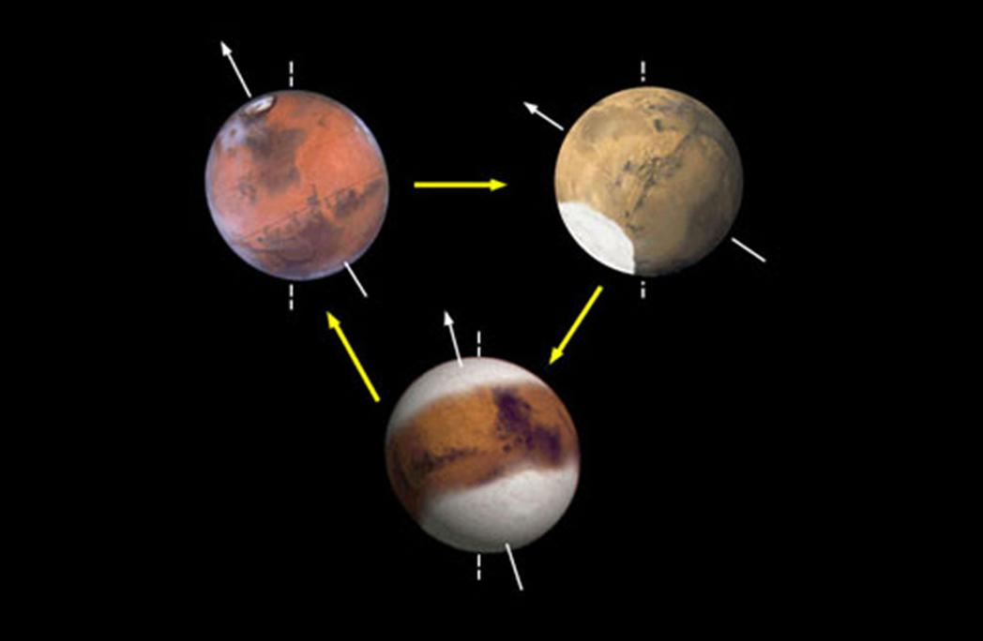
Tilt of Mars Rotation Axis
Ice migration at various changes of tilt
Very Low Obliquities 0º - 20º = poles grow larger at (BOTTOM)
Average Obliquities 25º (present) = ice is present in relatively modest quantities at the north and south poles (TOP LEFT)
High Obliquities 30º - 60º = This schematic shows that ice builds up near the equator at (TOP RIGHT)

Slide 12
Tilt of Mars Rotation Axis
Atmosphere
The thin atmosphere on Mars does not allow liquid water to exist at the surface for long
Thin atmosphere provides not protection to cosmic radiation and isn’t thick enough to hold in the gasses which are necessary to support life although there is evidence that they were present in the past
Composed of 95% Carbon Dioxide
Water on surface as well as in the atmosphere would have been absorbed by the Carbon Dioxide forming Carbonate Rocks
Atmosphere must be dense to have a Greenhouse effect which has any influence on the equilibrium temp of Mars
Greenhouse effect dimished + Equillibrium temp dropped + Remaining water froze = Uninhabitable Mars

Slide 13
Tilt of Mars Rotation Axis
Magnetosphere
Evidence collected by the Mars Global Surveyor (MGS) indicates that the planet may have once had a global magnetic field
Generated by an internal dynamo which faded over time
The planet’s magnetic field reversed direction, or flipped, several times in its early days as conditions in the mantle and core of the planet changed
Scientists continue to explore these processes on Mars and how they relate to magnetic processes on Earth
Earth's magnetic field is:
Clearly identifiable field lines
Magnetic lines of force that define an intangible bubble of electromagnetic energy around the planet
The magnetic signature that defines the field around Earth acts like a protective shield from harmful solar and cosmic radiation
NASA's Mars Global Surveyor orbiter found that areas of the Martian crust in the southern hemisphere are highly magnetized, indicating traces of a magnetic field from 4 billion years ago that remain

Slide 14
Tilt of Mars Rotation Axis
Pressure Variation
Seasons change roughly every seven months:
Spring beginning around the end of May
Summer beginning around the middle of December
Fall beginning in June
Winter beginning in November
Summer
During winter the global atmospheric pressure on Mars is 25% lower than during summer.
This happens because of the eccentricity of Mars's orbit and a complex exchange of carbon dioxide between the Martian dry-ice polar caps and its CO2 atmosphere.
Around the winter solstice when the North Pole is tilted away from the Sun, the northern polar cap expands as carbon dioxide in the polar atmosphere freezes.
At the other end of the planet the southern polar cap melts, giving CO2 back to the atmosphere.
Process reverses half a year later at the summer solstice.
Winter
Mars is 10% closer to the Sun in winter than it is in summer.
At the time of the winter solstice the northern polar cap absorbs more CO2 than the southern polar cap absorbs half a year later.
The difference is so great that the Martian atmosphere is noticeably thinner during winter.

Slide 15
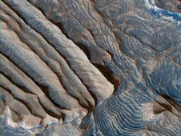
Tilt of Mars Rotation Axis
Rock Layering
High Resolution Imaging Science Experiment camera
May rekindle debates about some patterns of rock layering on Earth.
Layers of similar thickness repeat dozens to hundreds of times in rocks exposed
Bundles of a 10-layer pattern repeat at least 10 times, which could correspond to a known 10-to-one pattern of changes in the tilt of the planet's rotation axis.

Slide 16
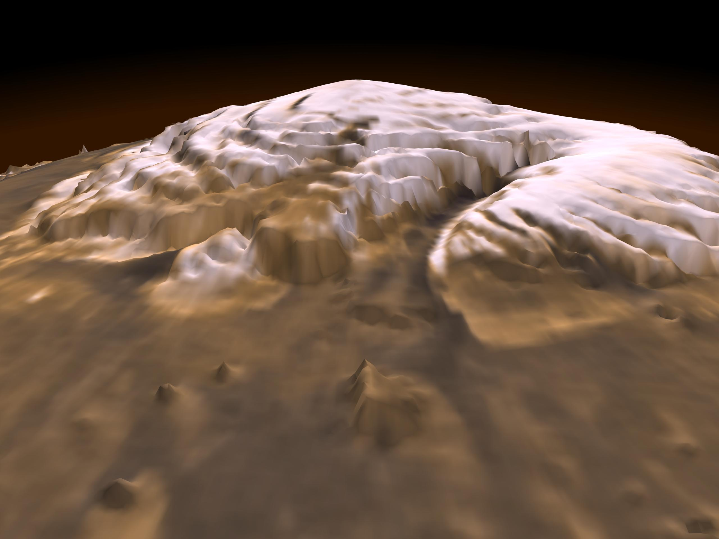
Water
Main Water Topics
Ancient Lakes/Rivers
Polar Ice Caps hold Water

Slide 17
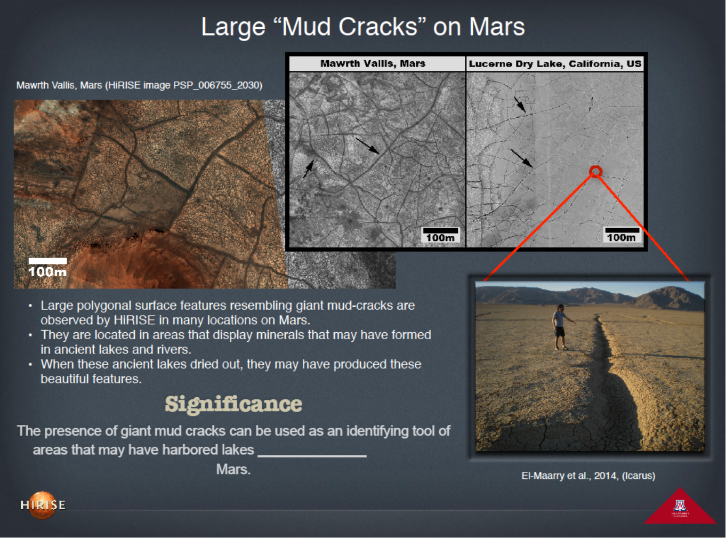
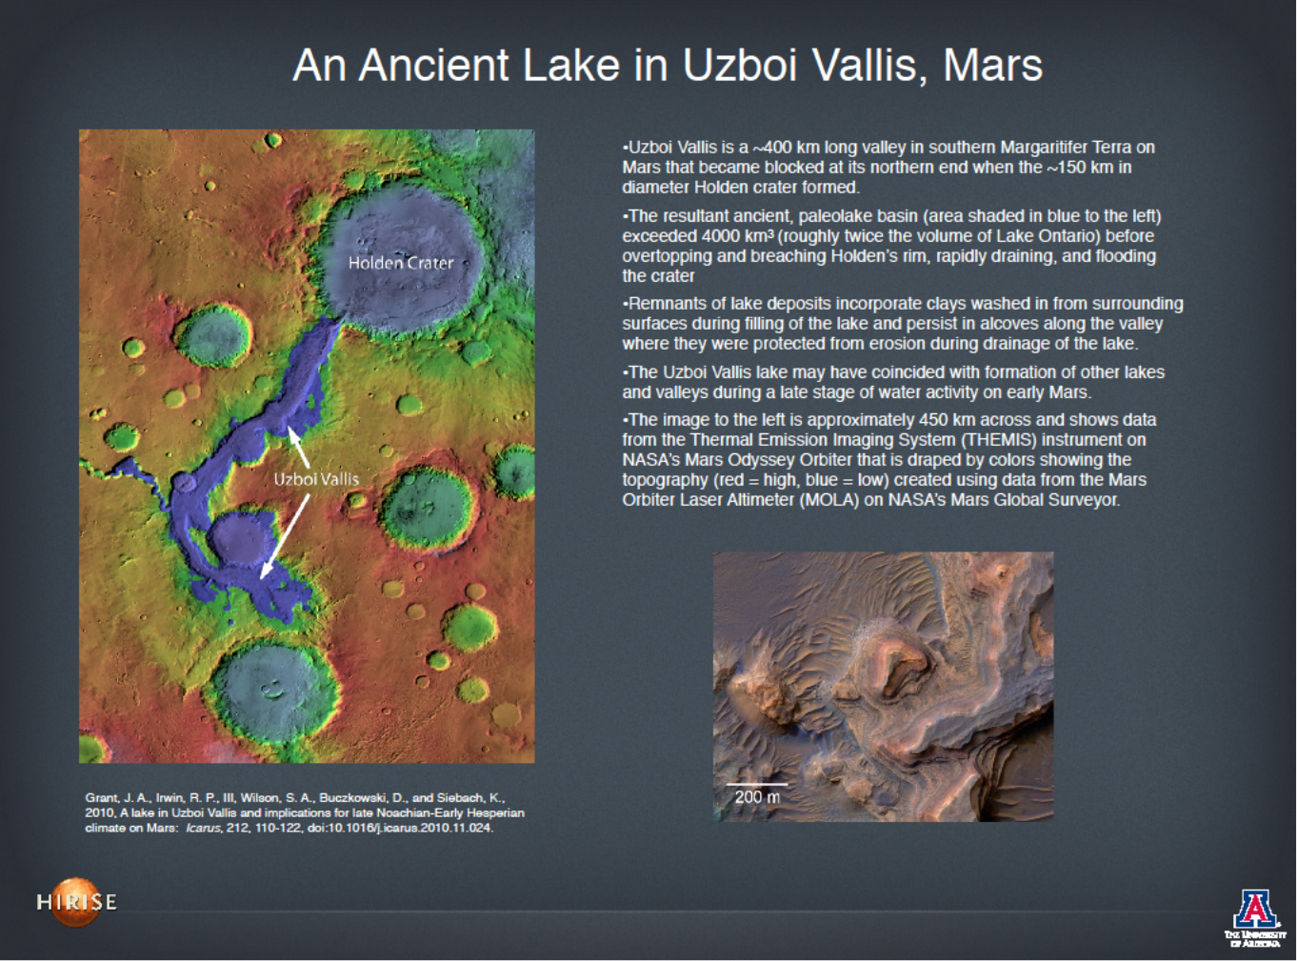
Water
Ancient Lakes/Rivers
Mud cracks
provide evidence of a past body of water
Origin and Flow
Formed by Craters impacts and other naturally occurring processes
River broke through the Holden crater wall and resultantly lowered the water level in the ancient river (evident from erosion layering)

Slide 18
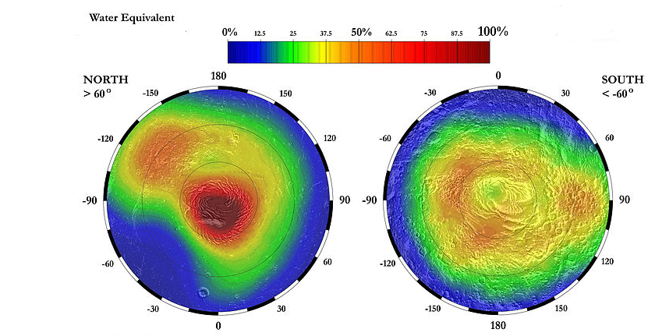
Water
Water Abundance
Polar Ice Caps hold Water
Northern Ice Cap is mostly frozen water
Southern Ice Cap is frozen water and carbon dioxide
Northern Ice Cap extends over a sizeable portion of the planet's pole similar to Earths
Non-seasonally affected size is several times greater than Southern Ice Cap
Mars currently contains as much as water as Lake Ontario in the Northern Polar Ice Cap
Martian Summer causes Carbon Dioxide Ice to sublimate uncovering Water Ice
Warming of the poles and partial melting of water ice at high altitudes broadens the environments in which life might occur on Mars
http://www.nasa.gov/mpeg/55074main_PolarCaps.mpeg (comparison)

Slide 19
References
"HiRISE Onboard Reconnaissance." HiRISE. N.p., n.d. Web. 07 Dec. 2014. <http://www.uahirise.org/>.
"HiRISE | Science Themes: Climate Change." HiRISE | Science Themes: Climate Change. N.p., n.d. Web. 10 Dec. 2014. <http://www.uahirise.org/science_themes/climate.php>.
Dunbar, Brian. "Phoenix Site on Mars May Be in Dry Climate Cycle Phase."NASA. NASA, 15 Dec. 2008. Web. 10 Dec. 2014. <http://www.nasa.gov/mission_pages/phoenix/news/phoenix-20081215.html>.
"NASA Mars Rovers Head for New Sites After Studying Layers." JPL. N.p., n.d. Web. 10 Dec. 2014. <http://www.jpl.nasa.gov/news/news.php?release=2006-054>.
"NASA Orbiter Catches Mars Sand Dunes in Motion." JPL. N.p., n.d. Web. 10 Dec. 2014. <http://www.jpl.nasa.gov/news/news.php?release=2011-358>.
Laskar et al., 2002; Head et al., 2003).

Slide 20


Questions

Slide 21
Questions
Will humans ever have the ability to make Mars Habitable?
extract oxygen from the Red Planet's carbon-dioxide atmosphere
Can we use the water on mars as a backup source if our fresh water supply runs out?
Northern and Southern Ice Caps are comprised of Fresh water ice, so I would assume yes if we found a way to do it
Did mars ever have life?
Microbial show good evidence but out chemistry experiments being conducted aren’t conclusive enough yet to know

